Slide 1
Course code : CSE3009 Course title : No SQL Data Bases Module : 1 Topic : 3
Comparing ACID and BASE

Slide 2
Objectives
This session will give the knowledge about
Understanding RDBMS and ACID transactions
Understanding NoSQL and BASE transactions
ACID vs BASE

Slide 3
Two methods of reliable database transactions
Transaction control is important in distributed computing environments with respect to performance and consistency.
Typically one of two types of transaction control models are used:
ACID, used in RDBMS, and
BASE, found in many NoSQL systems.
The difference between these models is in the amount of effort required by application developers and the location (tier) of the transactional controls.

Slide 4
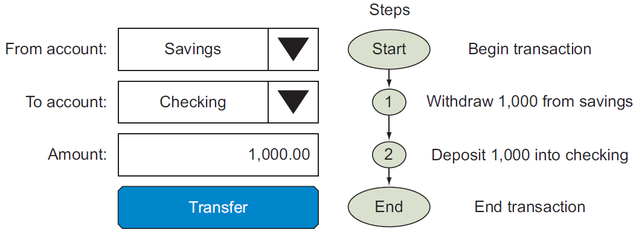
Database transactions - Example
Consider this example

Slide 5
Database transactions - Example
Two Operations: The funds are subtracted from your savings account and then added to your checking account.
Transaction management is the process of making sure that these two operations happen together as a single unit of work or not at all.
RDBMS have made it easy for programmers to make transactions reliable by wrapping critical transactions in statements that indicate where transactions begin and end.
These are often called BEGIN TRANSACTION and END TRANSACTION statements.
By adding them, developers can get high-reliability transaction support.

Slide 6
RDBMS transaction control using ACID
RDBMSs maintain transaction control by using atomic, consistent, independent, and durable (ACID) properties to insure transactions are reliable.
Atomicity - In the banking transaction example, we said that the exchange of funds from savings to checking must happen as an all-or-nothing transaction. The technical term for this is atomicity
Consistency - In the banking transaction example, we talked about the fact that when moving funds between two related accounts, the total account balance must never change. This is the principle of consistency

Slide 7
RDBMS transaction control using ACID
Isolation - Isolation refers to the concept that each part of a transaction occurs without knowledge of any other transaction. For example, the transaction that adds funds doesn’t know about the transaction that subtracts funds from an account.
Durability - Durability refers to the fact that once all aspects of a transaction are complete, it’s permanent. Once the transfer button is selected, you have the right to spend the money in your checking account.

Slide 8
Drawbacks of RDBMS
It’s very complex and relational databases can be expensive.
Many RDBMSs restrict transaction location to a single CPU.
Although ACID transactions is complex, there are well-known and well publicized strategies to do this.
All of them depend on locking resources, putting extra copies of the resources aside, performing the transaction and then, if all is well, unlocking the resources.
ACID systems focus on the consistency and integrity

Slide 9
Non-RDBMS transaction control using BASE
Consider you have a website that relies on computers all over the world.
A computer in USA manages your inventory,
Product photos are on an image database in UK,
Tax calculations are performed in India, and
Your accounting system is in Australia.
What if one site goes down?
Should you tell your customers to check back in 20 minutes while you solve the problem?
Is it realistic to use ACID software for every order that comes in?

Slide 10
Non-RDBMS transaction control using BASE
The BASE model (Basically Available, Soft state, Eventual consistency) is often used instead of the traditional ACID properties to handle transactions.
BASE is designed to achieve high availability and scalability, sacrificing some consistency guarantees for better performance and fault tolerance.
BASE guarantees that the system remains operational even when some of its components fail.
By relaxing consistency requirements, BASE systems can provide faster responses to queries and updates, reducing the overall latency experienced by end-users.

Slide 11
Non-RDBMS transaction control using BASE
Basically Available:
The system guarantees availability, meaning it will always respond to requests, even if the responses are not immediately consistent.
This ensures that the system remains operational under various conditions, including network partitions.
A retail website like Amazon needs to handle millions of transactions during a sale event. To ensure the system remains available, the database might allow some flexibility in data consistency. For instance, if a product's inventory is temporarily out of sync due to high demand, the website still allows users to add items to their cart, and updates the inventory asynchronously.

Slide 12
Non-RDBMS transaction control using BASE
Soft State:
The state of the system may change over time, even without input, due to the asynchronous propagation of updates.
The system does not need to be immediately consistent, allowing for greater flexibility in handling data.
A distributed database used by a global social media platform like Facebook might have nodes spread across different regions. As users update their profiles or post new content, these changes might not be immediately reflected in all nodes. The system's state is considered "soft" because it is continually changing and eventually synchronizes across all nodes.

Slide 13
Non-RDBMS transaction control using BASE
Eventual Consistency:
The system guarantees that, given enough time, all replicas will converge to the same state.
This allows for temporary inconsistencies while ensuring long-term data integrity.
In a NoSQL database like Cassandra used by Netflix, when a user updates their watchlist, the update might not be instantly visible across all devices due to network latency or partitioning. However, within a short period, all copies of the data across different nodes will eventually be consistent, ensuring that the user's watchlist is accurately reflected on all devices.

Slide 14
Conclusion
Unlike RDBMSs that focus on consistency, BASE systems focus on availability
They relax the rules and allow reports to run even if not all portions of the database are synchronized.
BASE systems tend to be simpler and faster because they don’t have to write code that deals with locking and unlocking resources.
BASE systems are ideal for web storefronts, where filling a shopping cart and placing an order is the main priority.
NoSQL systems are highly decentralized and ACID guarantees may not be necessary, so they use BASE and take a more relaxed approach

Slide 15
ACID vs BASE
ACID | BASE
Atomicity, Consistency, Isolation, Durability | Basically Available, Soft state, Eventual consistency
Strong consistency; transactions always bring the database from one valid state to another | Eventual consistency; the system will become consistent over time
May sacrifice availability for consistency, especially during network partitions | Prioritizes availability, always responds to requests even if data is inconsistent
Maintains a hard state; transactions always leave the database in a valid state | Maintains a soft state; data may change over time until it becomes consistent

Slide 16
ACID vs BASE
ACID | BASE
Transactions are atomic, all-or-nothing | Transactions are not necessarily atomic; some parts may be partially complete
Transactions are isolated, intermediate states are not visible | Intermediate states may be visible, and updates propagate asynchronously
Once a transaction is committed, it remains so even in the event of a system crash | Durability is less emphasized, focusing more on availability and partition tolerance
Suitable for financial systems, banking, transaction processing where data integrity is crucial | Suitable for distributed systems, social media platforms, online shopping where high availability is critical
PostgreSQL, MySQL, Oracle | Cassandra, DynamoDB, Couchbase

Slide 17
At Conclusion
ACID and BASE aren’t rigid points on a line; they lie on a continuum where organizations and systems can decide where and how to architect systems.
They may allow ACID transactions on some key areas but relax them in others.
Some database systems offer both options by changing a configuration file or using a different API.
When the amount of data you manage exceeds the size of your current system and you need to use database sharding to keep systems running and minimize downtime.

Slide 18
Summary
This session will give the knowledge about
Understanding RDBMS and ACID transactions
Understanding NoSQL and BASE transactions
ACID vs BASE

